Slide 1
BGP Routing
Learning Outcomes:
BGP Fundamentals: Overview of the fundamentals of the BGP routing protocol.
Basic BGP Configuration: Process of configuring BGP to establish a neighbor session and how routes are exchanged between peers.
Route Summarization: Overview of how route summarization works with BGP and some of the design considerations with summarization.
Multiprotocol BGP for IPv6: Support for IPv6 routing and configuration.

Slide 2
1. BGP Fundamentals
RFC 4271 defines BGP as a standardized EGP path vector protocol
BGP Fundamentals :
Autonomous Systems (ASs) & Autonomous System Numbers (ASN)
Path Attributes (PAs)
Loop Prevention
Address Families
Inter-Router Communication
Notes:
RFC 1654 for BGP-4 and RFC 1655 defines ‘Application of the BGP in the Internet’
Wiki BGP

Slide 3
1. BGP Fundamentals: ASs & ASN
Autonomous Systems : Set of routers under single technical administration using single IGP and common metrics for internal/local traffic routing (within ASs) and using EGP for routing between ASs.
Autonomous System Numbers (ASNs):
Original 2 bytes (16 bit-range) extended to 4 bytes (32-bit range ) numbers
Private ASNs to be used inside an organization and should not be advertised on public internet
Private ASN range 64,512–65,535 in 16-bit range & 4,200,000,000–4,294,967,294 in 32-bit range
Internet Assigned Numbers Authority (IANA) issues public ASNs
Requires below info to be eligible:
Proof of publicly allocated network ranges
Proof that internet connectivity is provided through multiple connections (Multihomed)
Need for an unique routing policy from providers
Check eligibility to get ASN in Australia through APNIC
Notes:
RFC 1654 for BGP-4 and RFC 1655 defines ‘Application of the BGP in the Internet’

Slide 4
1. BGP Fundamentals: Path Attributes
Path Attributes (PAs) :
Variable length sequence of PAs present in each UPDATE message.
Each PA consists of <attribute type, attribute length, attribute value>
Example: AS_Path, 3, (300,200,100)
BGP Prefix PAs are of following types:
Well-known Mandatory: Included with every prefix advertisement
Well-known discretionary: May or may not be included
Optional Transitive
Optional Non-transitive
Notes:
RFC 1654 for BGP-4 and RFC 1655 defines ‘Application of the BGP in the Internet’

Slide 5
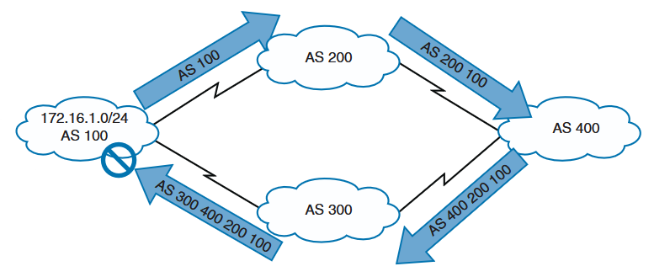
1. BGP Fundamentals: Loop Prevention
BGP behaves like distance vector protocol but is a path vector.
BGP well-known mandatory attribute AS_PATH is used for loop prevention
AS_PATH contains all the ASs that the prefix has traversed from it's source.
If a BGP router receives prefix advertisement with it's own ASN in AS_PATH attribute, it discards the advertisement as possible loop.
Notes:
RFC 1654 for BGP-4 and RFC 1655 defines ‘Application of the BGP in the Internet’

Slide 6
1. BGP Fundamentals: Address Family
Address Family :
Multi-Protocol BGP (MBGP) supports multiple protocol by use of Address Family Identifier (AFI) and Subsequent AFI (SAFI)
Example - AFI: IPv4 or IPv6, SAFI: unicast or multicast
Every address family (AFI +SAFI) maintains separate database and configuration to associate them with correct routing policy.
But BGP can use same session for multiple address families.
BGP differentiates between multiple address families by including (AFI+SAFI) PA in advertisements.
Notes:
RFC 1654 for BGP-4 and RFC 1655 defines ‘Application of the BGP in the Internet’

Slide 7
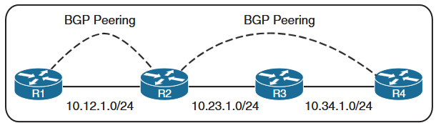
1. BGP Fundamentals: Inter-Router Communicaiton
BGP is for Inter-Autonomous System communication
IGPs discover directly connected neighbors only (single hop) with Hello.
BGP can form adjacency with multiple hop away routers as well by use of TCP port 179.
For multi-hop BGP session to form over TCP, underlying network reachability between peers is required.
Static routes or IGPs can be used to provide layer 3 connectivity. (R2 and R4)
BGP peer on same subnet/network reach each other via ARP.(R1 and R2)
Notes:
RFC 1654 for BGP-4 and RFC 1655 defines ‘Application of the BGP in the Internet’

Slide 8
1. BGP Fundamentals: Inter-Router Communication
Internal BGP (iBGP):
BGP session within an AS is iBGP
Administrative Distance(AD) of iBGP is 200
iBGP is required to provide transit connectivity between AS or for multiple routing policies.
Using IGP instead of iBGP is not possible:
Scalability: BGP table is use and cannot be accommodated by IGP protocols.
Custom Routing: IGPs use metric as best path calculation but BGP uses several logic for best path calculation.
Path Attribute Compatibility: BGP needs to advertise/forward at least well-known mandatory PAs which cannot be carried forward with IGPs.
Notes:
RFC 1654 for BGP-4 and RFC 1655 defines ‘Application of the BGP in the Internet’

Slide 9
1. BGP Fundamentals: Inter-Router Communicaiton
External BGP (eBGP):
Exchange of network prefixes between ASes
Administrative Distance of eBGP is 20
Operational differences of iBGP and eBGP:
TTL on eBGP is 1(single hop), and on iBGP is 255 (multi-hop).
Advertising router modifies the BGP next hop to ip address sourcing the BGP connection.
Advertising router prepends it's own ASN to AS_PATH attribute.
Receiving router checks the AS_PATH attribute for it's own ASN for loop prevention.
Notes:
RFC 1654 for BGP-4 and RFC 1655 defines ‘Application of the BGP in the Internet’

Slide 10
1. BGP Fundamentals: Inter-Router Communicaiton
Message Types:
Type 1 – OPEN :
Advertises configuration (ASN, Version, BGP Identifier, HoldTime etc.) and capabilities after BGP start.
UPDATE or KEEPALIVE resets HoldTime
A non-zero RID can be set manually or dynamically as BGP Identifier
Type 2 – UPDATE:
Used to advertise or withdraw routes or both simultaneously.
Contains Withdrawn Routes field, PA field and Network Layer Reachibility Information (NLRI) field.
NLRI and PA field are used for advertising routes and Withdrawn Routes field to withdraw routes.
UPDATE message can act as KEEPALIVE message.
Type 3 – NOTIFICATION:
Sent when error condition is detected.
BGP connection is closed immediately after the message.
Type 4 – KEEPALIVE:
Every one-third of the HoldTime, KEEPALIVE messages are sent to maintain BGP adjacency.
For default HoldTime of 180 seconds, KEEPALIVE message interval is 60 seconds.
If HoldTime is set to 0, then no KEEPALIVE messages are sent.
Notes:
RFC 1654 for BGP-4 and RFC 1655 defines ‘Application of the BGP in the Internet’

Slide 11
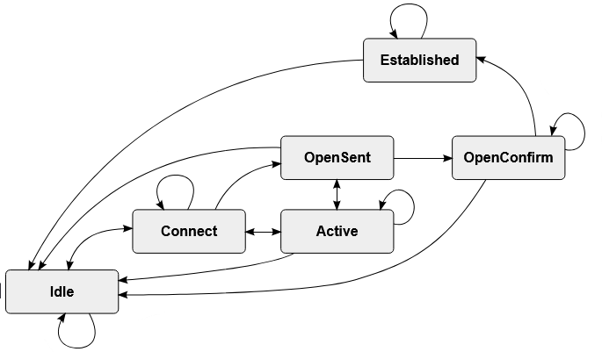
1. BGP Fundamentals: Inter-Router Communication
BGP Neighbor States: FSM
For each BGP peering/TCP connection one FSM is maintained.
IDLE:
Detects start event, initialises BGP resources and initiates TCP connection. Also listens for incoming TCP connection.
An error causing the router to stay in IDLE state will reset the ConnectRetryTimer to 60 seconds
Subsequent errors preventing to get out of IDLE state will double the ConnectRetryTimer.
ConnectRetryTimer is the time router waits before trying to setup TCP connection.
CONNECT:
BGP is performing/waiting for TCP 3-way handshake to complete.
On completion, ConnectRetryTimer is reset and OPEN message is sent. State changes to OPENSENT.
If ConnectRetryTimer depletes before completion, new connection is initiated and ConnectRetryTimer is reset.
If TCP connection fails, BGP goes to ACTIVE state. If any other input is received, it goes to IDLE state.
ACTIVE :
ACTIVE state is the Retry mechanism to establish TCP connection.
Starts new TCP 3-way handshake
If successful, BGP sends OPEN message, sets its HoldTimer to 4 minutes and changes to OPENSENT state.
IF unsuccessful, it resets ConnectRetryTimer and changes to CONNECT state.
Notes:
RFC 1654 for BGP-4 and RFC 1655 defines ‘Application of the BGP in the Internet’

Slide 12
1. BGP Fundamentals: Inter-Router Communicaiton
OPENSENT​:
BGP has sent OPEN message and is waiting for OPEN message from peer.
Once OPEN message from peer is received, message contents are validated (same BGP version, correct peer ASN, non-overlapping RID and same capabilities).
On successful validation, HoldTimer(lower value) is negotiated with peer, KEEPALIVE message is sent and state transitions to OPENCONFIRM.
Unsuccessful validation will send NOTIFICATION message and state transitions to IDLE.
Any TCP error, BGP closes the connection, resets ConnectRetryTimer and transitions to ACTIVE state.
OPENCONFIRM​:
BGP waits for a KEEPALIVE or NOTIFICATION message.
Upon receipt of a neighbor’s KEEPALIVE message, the state is moved to ESTABLISHED.
If the hold timer expires, a stop event occurs, or if a NOTIFICATION message is received, the state is moved to IDLE.
ESTABLISHED​:
Routes are exchanged with UPDATE message
On receiving UPDATE or KEEPALIVE, HoldTimer is reset.
If HoldTimer expires, BGP moves to IDLE state.
Notes:
RFC 1654 for BGP-4 and RFC 1655 defines ‘Application of the BGP in the Internet’

Slide 13
1. BGP Configuration
Basic configuration:
BGP Session Parameters:
router bgp asn
bgp log-neighbor-changes
Address Family Initialization:
Activate Address Family on Peers:
Refer to BGP lab manual for other sections of this slide deck.
Notes:
RFC 1654 for BGP-4 and RFC 1655 defines ‘Application of the BGP in the Internet’

